Slide 1

NLP PROJECT
Build a Job Description and Resume Matching System
Tanishka
21CSU491

Slide 2
INTRODUCTION
In the recruitment process, matching candidate resumes to job descriptions is a critical yet time-intensive task. Automating this process using natural language processing (NLP) techniques and machine learning can significantly reduce effort and improve accuracy. This project implements a resume-ranking tool that compares candidate resumes to a given job description using TF-IDF vectorization and cosine similarity.
The tool processes resumes in PDF, DOCX, and TXT formats, extracts their content, calculates similarity scores with a given job description, and outputs the top 5 ranked resumes. It offers a scalable and efficient solution for initial resume screening.

Slide 3
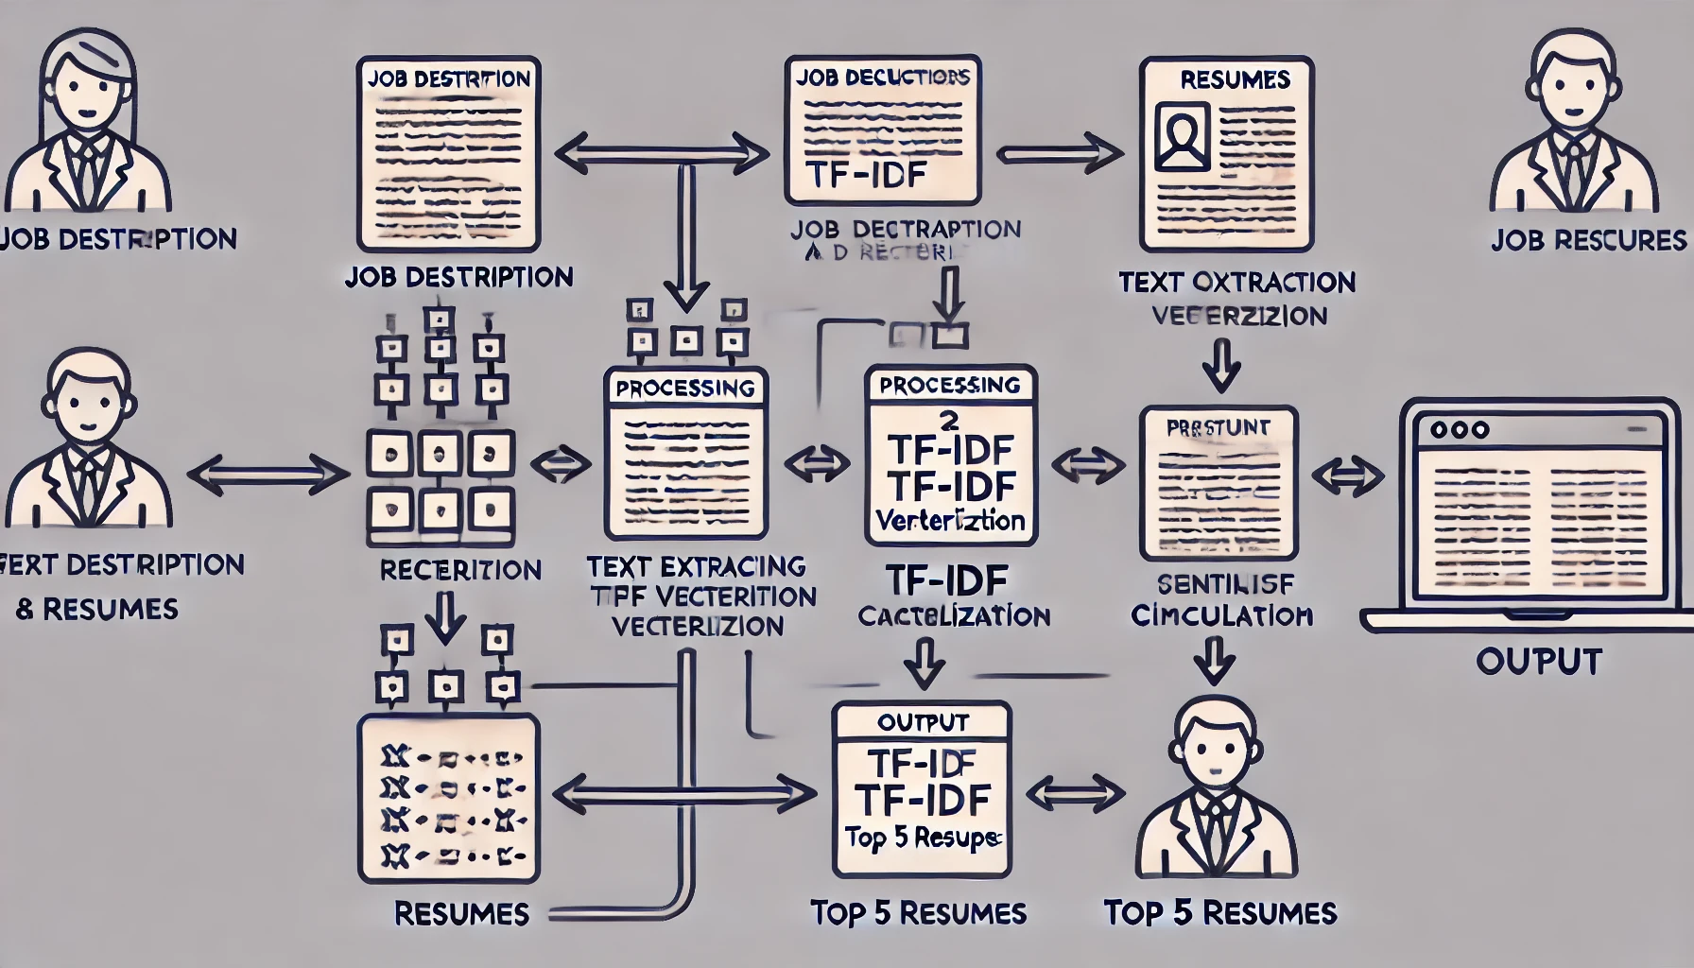
WORKFLOW STEPS
Input job description and resumes.
Validate file paths.
Extract text from resumes.
Vectorize text using TF-IDF.
Compute similarity using cosine similarity.
Rank resumes based on scores.
Display the top 5 matches.

Slide 4
CORE TECHNIQUES
TF-IDF (Term Frequency-Inverse Document Frequency):
Converts text into numerical vectors by evaluating the importance of words in a document relative to a corpus.
Cosine Similarity:
Measures similarity between two vectors by calculating the cosine of the angle between them.
Advantages:
Context-aware keyword matching.
Effective for short texts like resumes.

Slide 5

CODE STRUCTURE
Modules and Functions:
Text Extraction: Handles PDF, DOCX, and TXT formats.
TF-IDF Vectorization: Converts text to vectors.
Similarity Calculation: Computes cosine similarity.
Ranking: Sorts resumes based on relevance.
Error Handling: Skips unsupported or missing files.

Slide 6

RESULTS
Input: Example job description and a set of resumes.
Output: Ranked list of the top 5 resumes with similarity scores.
Benefits:
Automates tedious tasks.
Handles multi-format resumes effectively.
Produces accurate results for shortlisting candidates.

Slide 7
CONCLUSION AND FUTURE WORK
Conclusion:
Automated resume matching saves time and enhances initial screening efficiency.
Demonstrates the power of NLP in recruitment.
Future Work:
Add semantic analysis for deeper understanding.
Incorporate a graphical user interface (GUI).Extend support to more file formats.

Slide 8


